Slide 1

Introduction to Maven

Slide 2
Agenda
Apache Maven

Slide 3
Maven
What is Apache Maven?
Apache Maven is a software management and comprehension tool for java development

Slide 4
Maven
Objectives
Dependency Management
Compile Source Code
Run Unit Test
Build Project
Deploy Code

Slide 5
Maven
Repository
Central Repository
maven repository or internet repository
Remote Repository
organization repository
Local Repository
client repository (cache into .m2 folder under user home directory)
Notes:
How to change .m2 go to maven_home/conf/settings.xml
ex. <localRepository>/path/to/local/repo</localRepository>

Slide 6
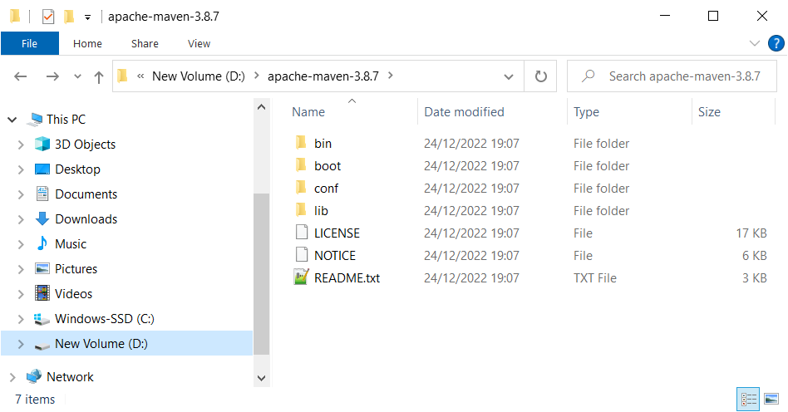
Maven
How To Maven
Go to https://maven.apache.org
Download & Install
ex. apache-maven-3.8.7-bin.zip

Slide 7
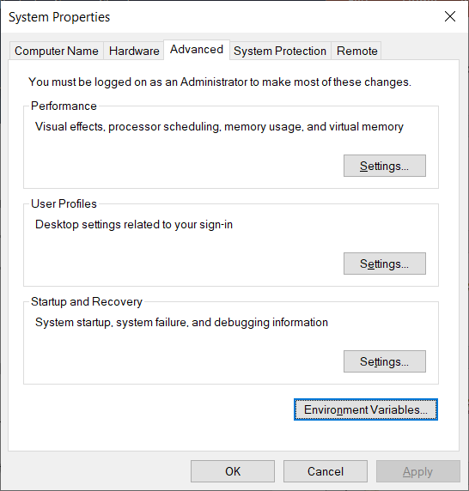
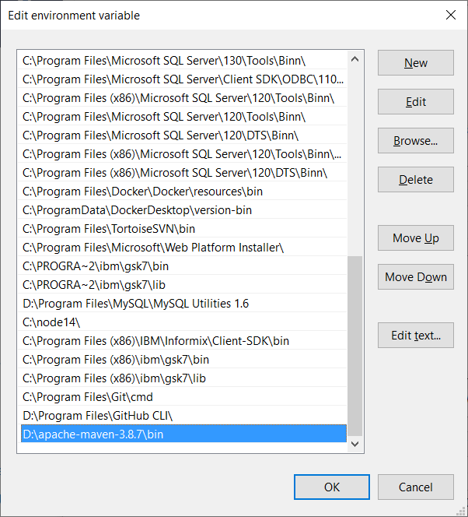
Maven
How To Maven
Setting Environment
Settings -> System -> About -> Advanced System Setting -> Advanced -> Environment Variables

Slide 8
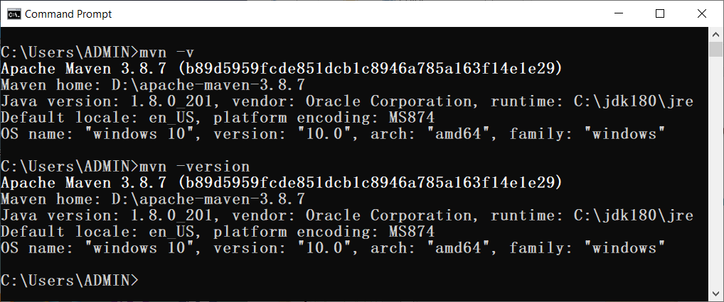
Maven
How To Maven
Examine
mvn -v or mvn --version

Slide 9
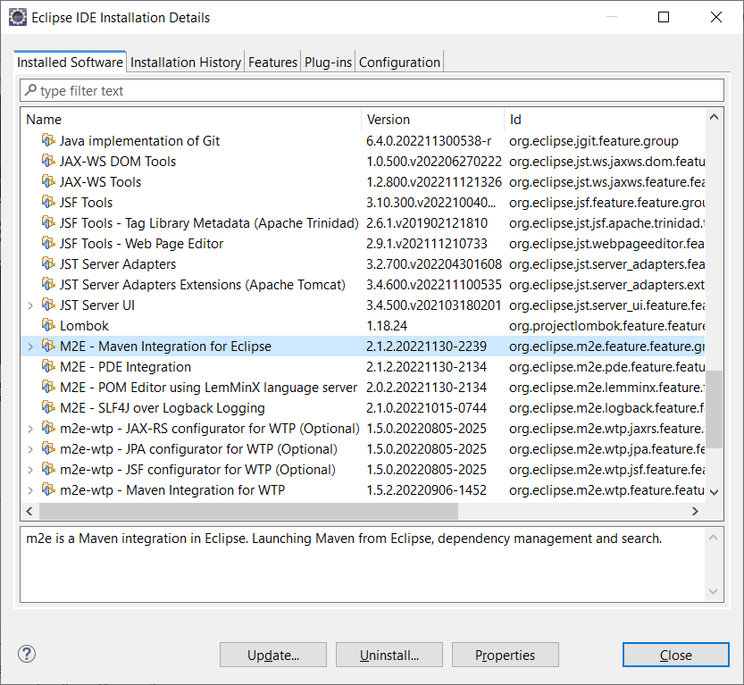
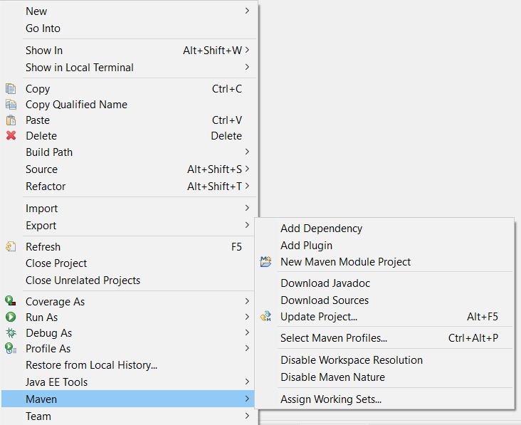
Maven
How To Maven
IDE Plugin

Slide 10
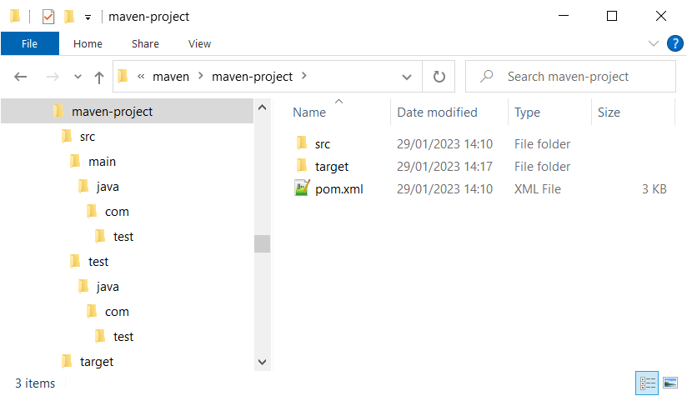
Maven
Project Structure
src folder – keep java file
target folder – keep class file
pom.xml – configuration file

Slide 11
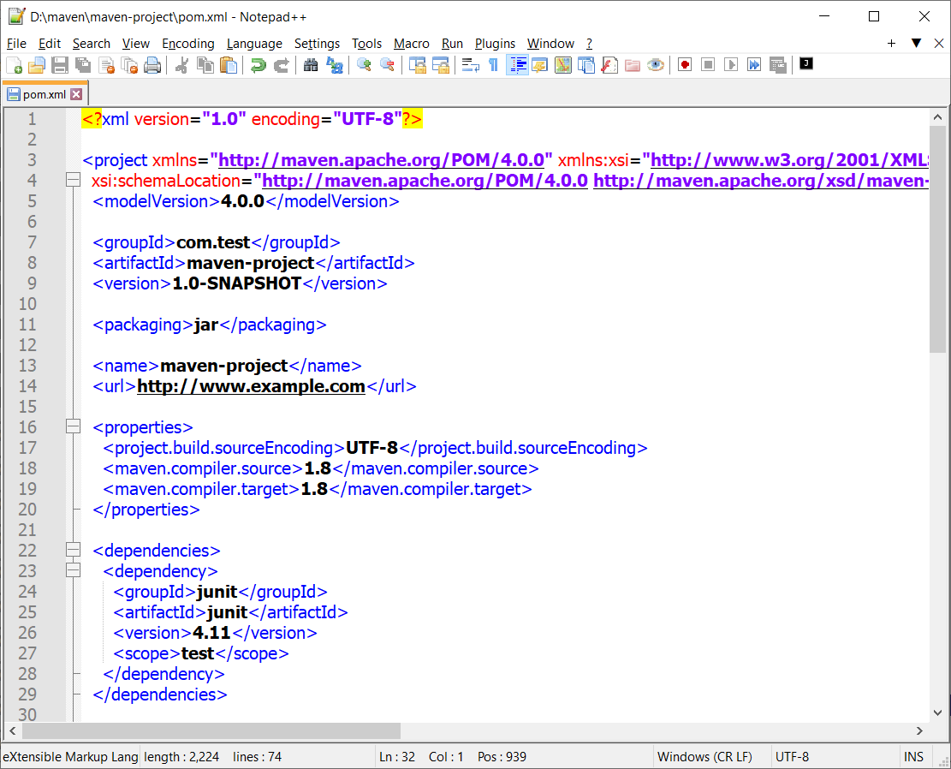
Maven
Project Object Model
pom.xml configuration file - I
Project Information
Output Result
Properties
Dependencies

Slide 12
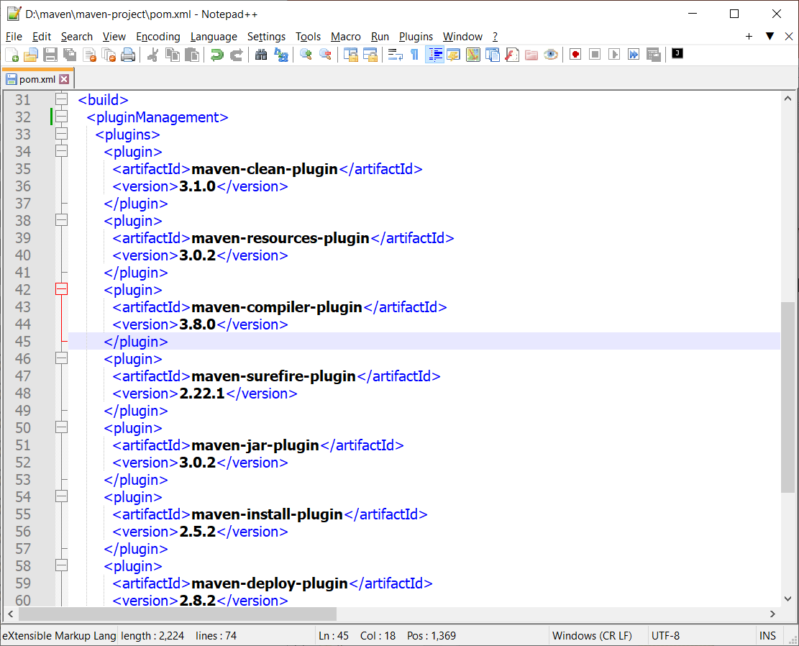
Maven
Project Object Model
pom.xml configuration file - II
Build Plugins

Slide 13
Maven
Project Object Model
Project Information
groupId – name space or project package
artifactId – unique application name
version – current version of artifact
Output Result – jar/war/ear
Properties – project configurations
Dependencies – project libraries
Build
plugins – requirement plugins

Slide 14
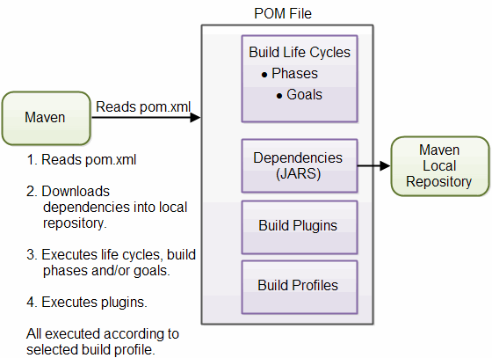
Maven
Project Object Model
Life Cycle
Notes:
Build life cycle
Validate 2. Compile 3. Test 4. Package 5. Install 6. Deploy

Slide 15
Maven
Command Line
Command | Description
mvn achetype:generate | Create new maven project
mvn compile | Compile java source code files
mvn test | Run test classes
mvn clean | Delete all class files
mvn package | Build jar/war file
mvn install | Build jar file and register to local repository (.m2 folder)

Slide 16
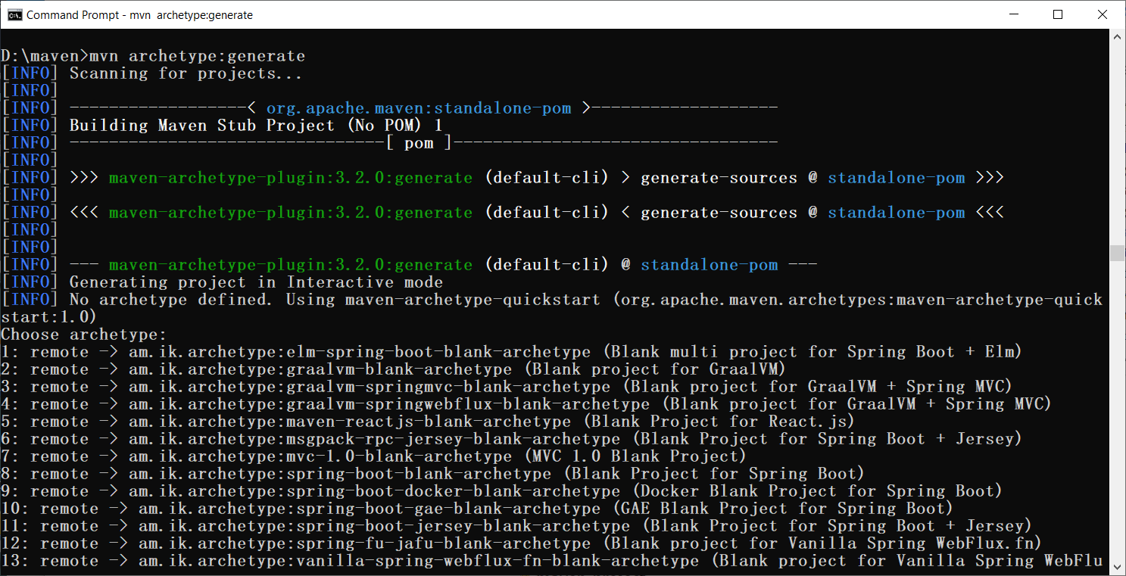
Maven
Command Line
mvn archetype:generate
jar package
Notes:
2005 - org.apache.maven.archetypes:maven-archetype-quickstart (jar)
2010 - org.apache.maven.archetypes:maven-archetype-webapp (war)

Slide 17
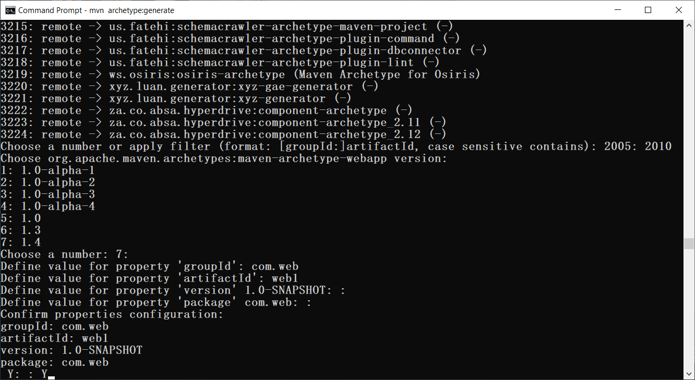
Maven
Command Line
mvn archetype:generate
war package
Notes:
2005 - org.apache.maven.archetypes:maven-archetype-quickstart (jar)
2010 - org.apache.maven.archetypes:maven-archetype-webapp (war)

Slide 18
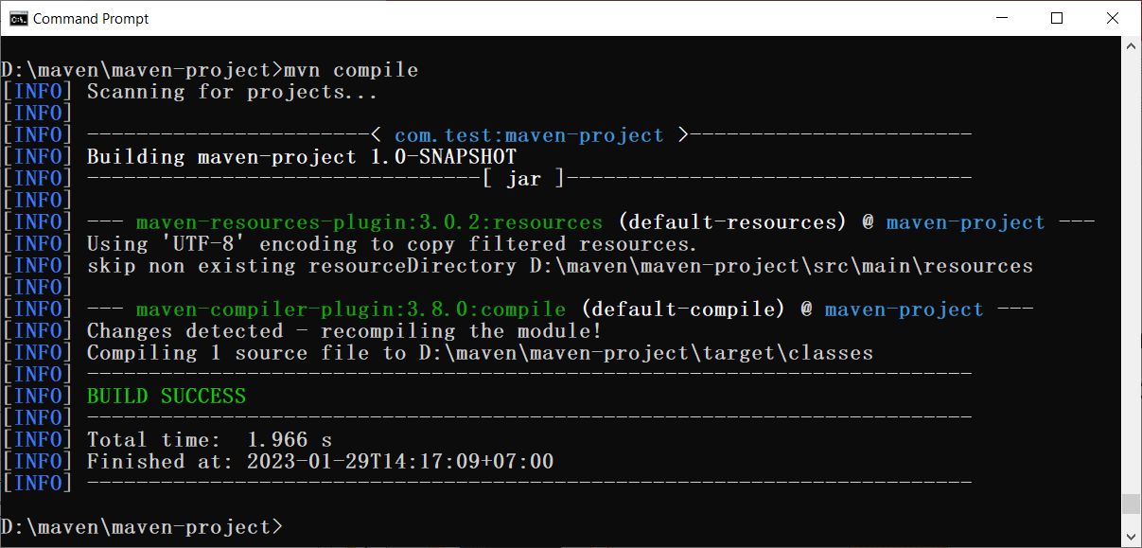
Maven
Command Line
mvn compile

Slide 19
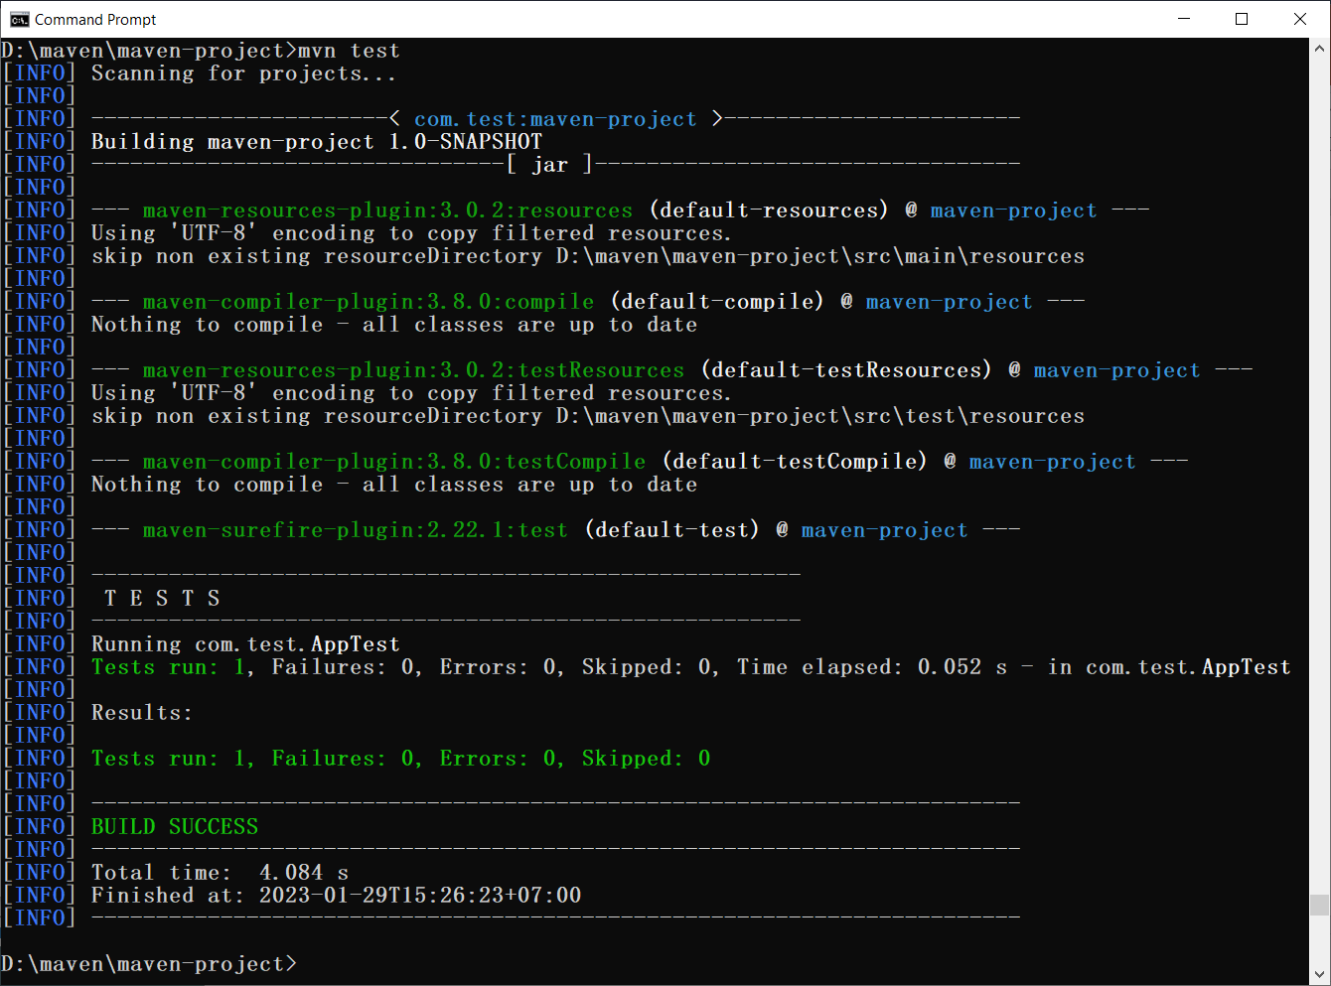
Maven
Command Line
mvn test

Slide 20
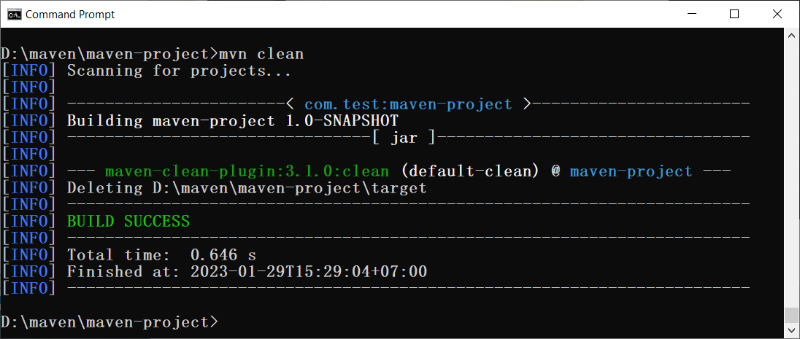
Maven
Command Line
mvn clean

Slide 21
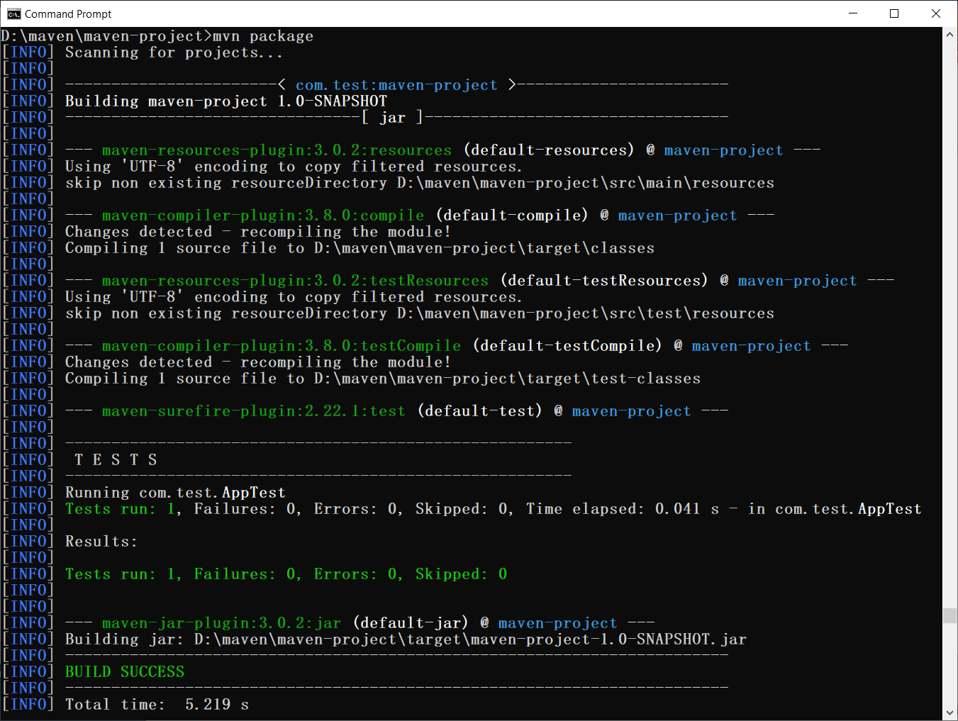
Maven
Command Line
mvn package

Slide 22
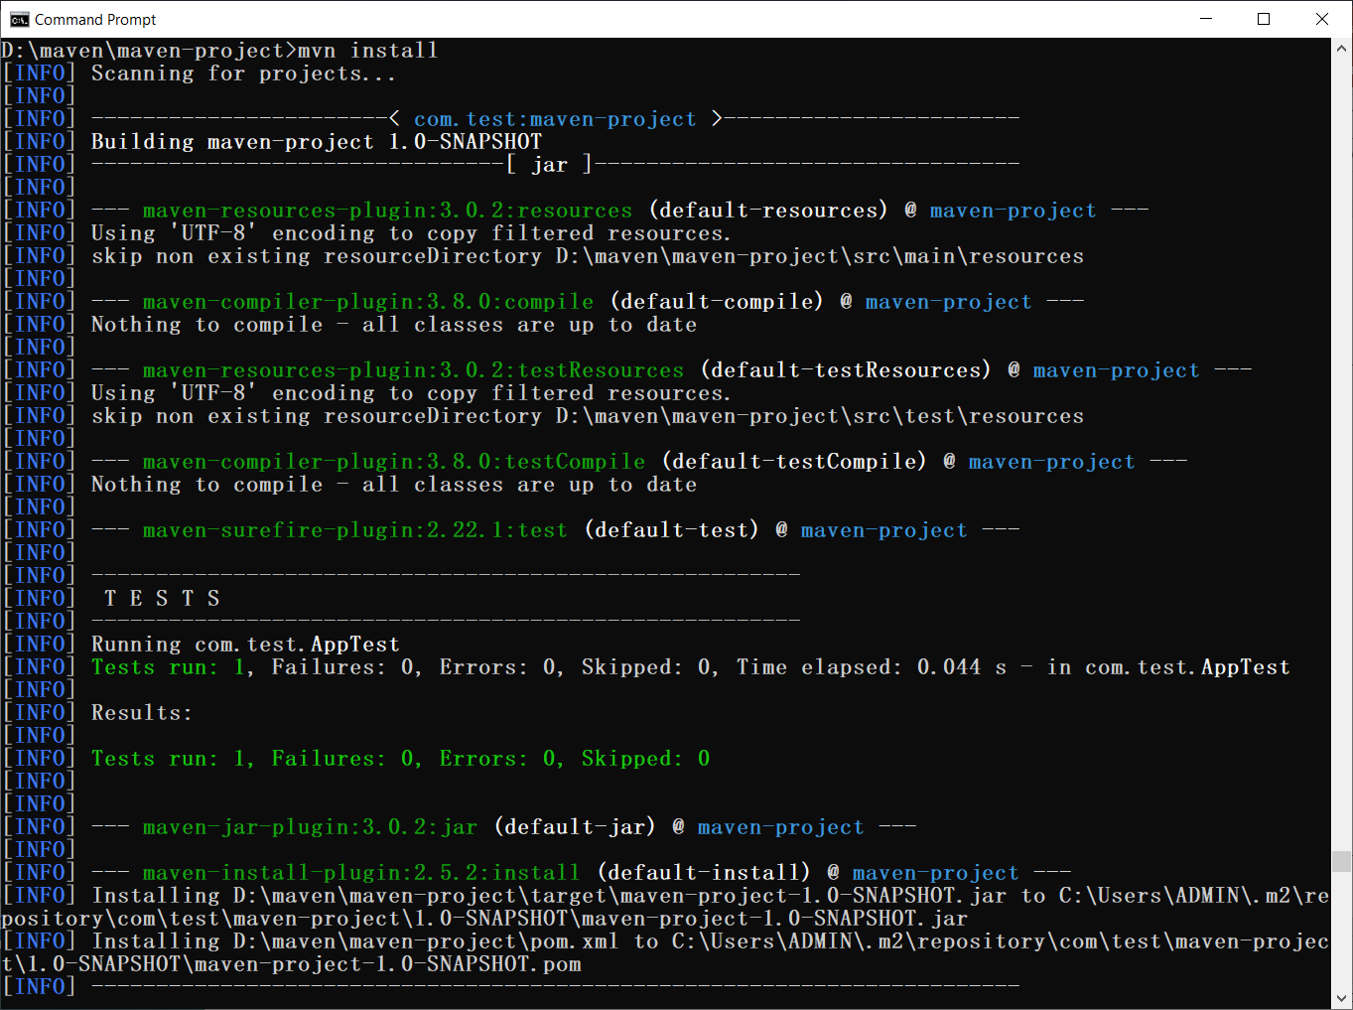
Maven
Command Line
mvn install

Slide 23
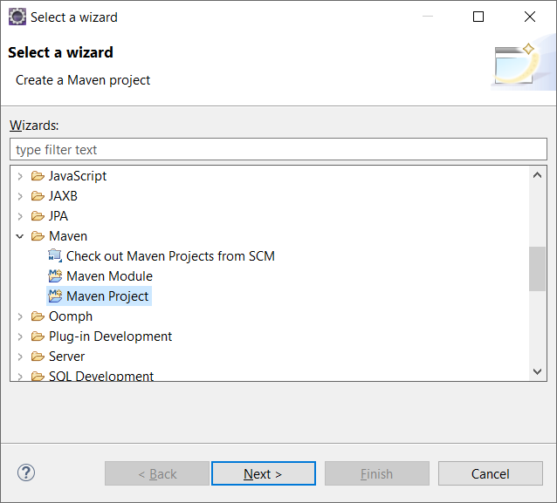
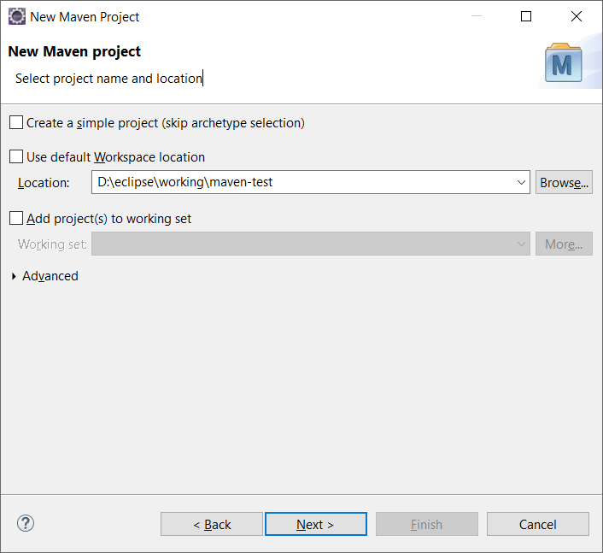
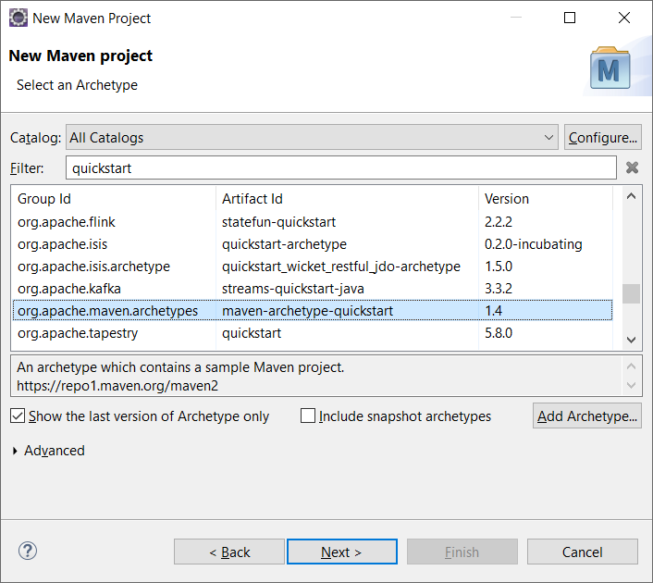
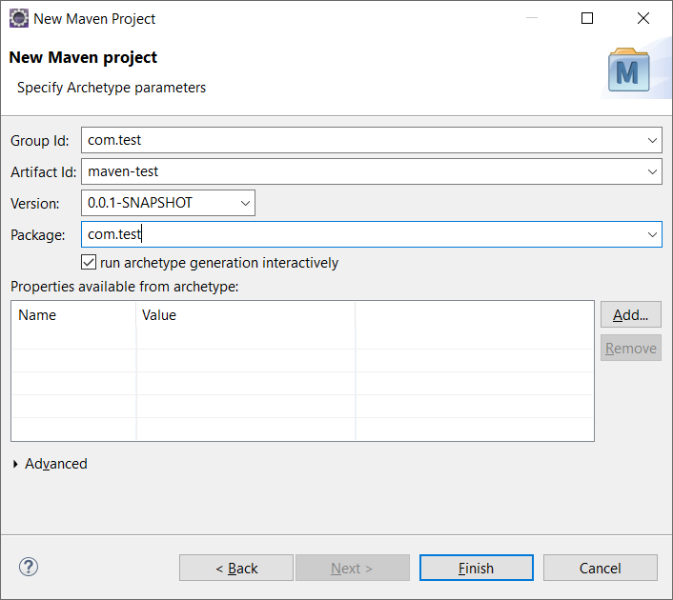
Maven
Eclipse IDE Plugin
File -> New -> Other (jar)
1
2
3
4

Slide 24
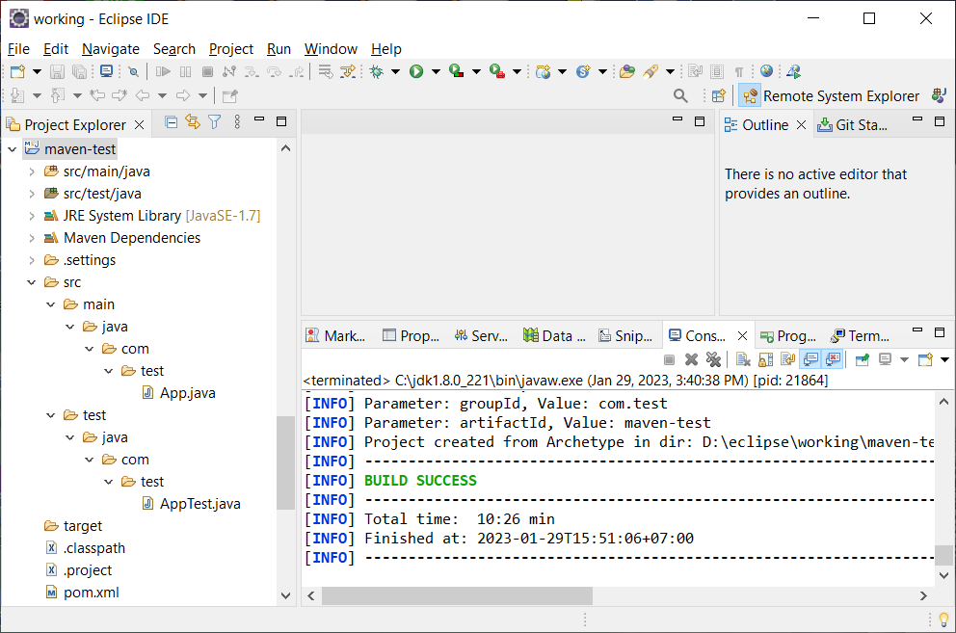
Maven
Eclipse IDE Plugin
java project

Slide 25
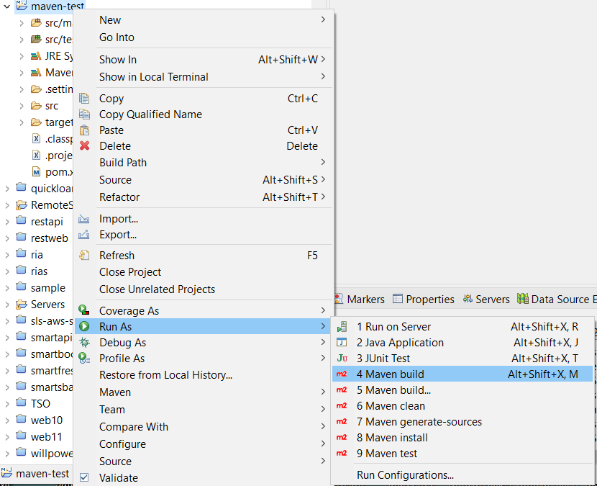
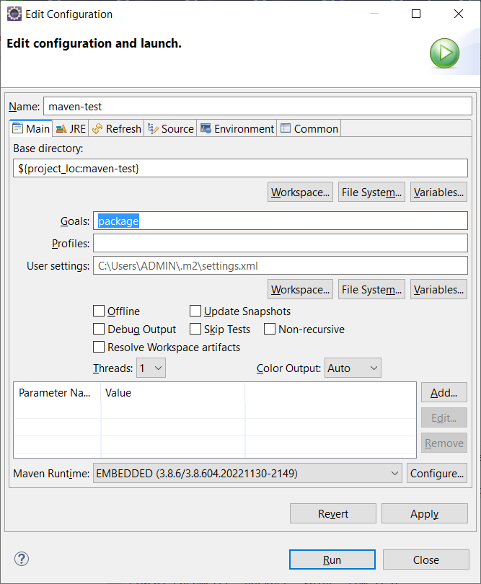
Maven
Eclipse IDE Plugin
build

Slide 26
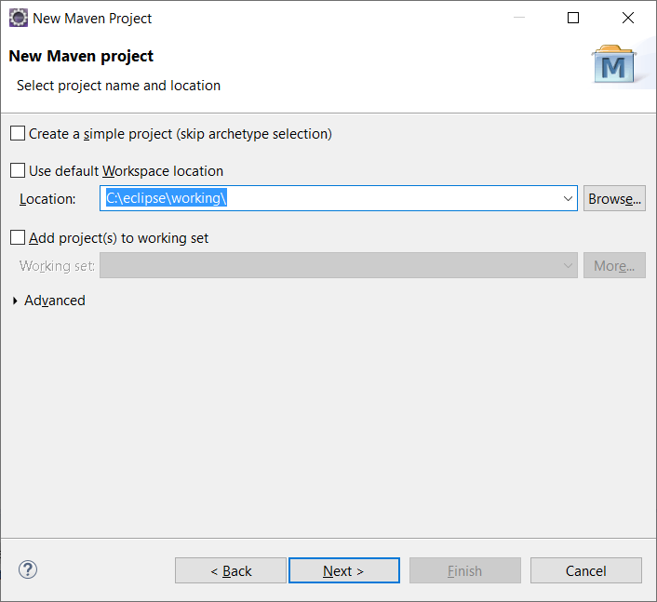
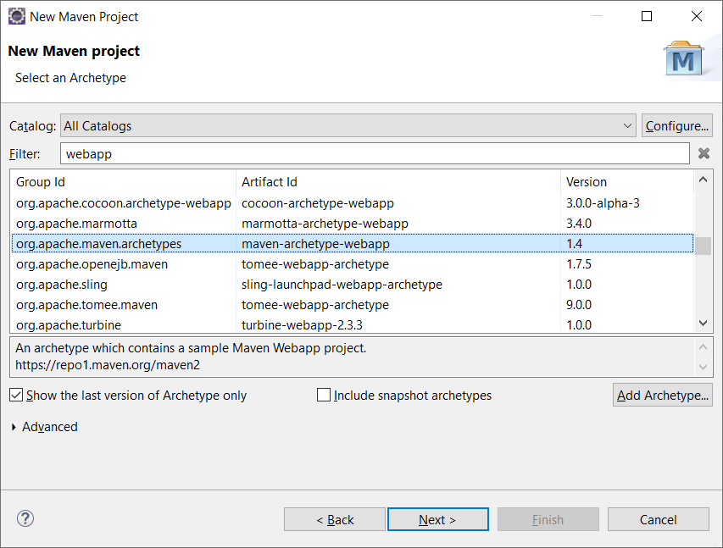
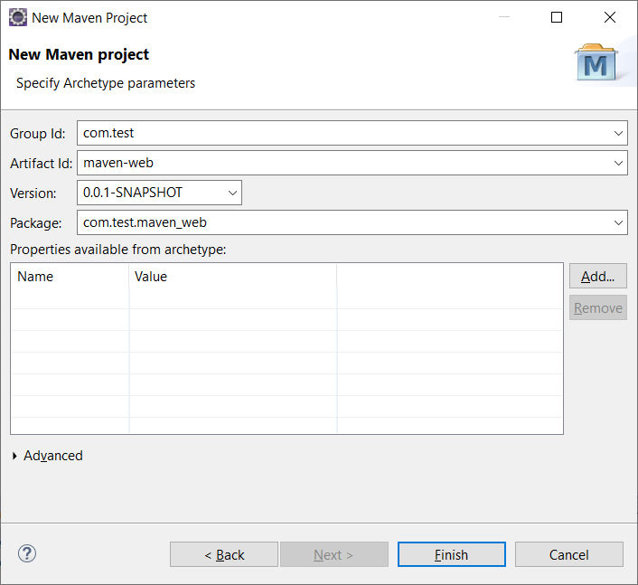
Maven
Eclipse IDE Plugin
File -> New -> Other (war)
1
2
3
4

Slide 27
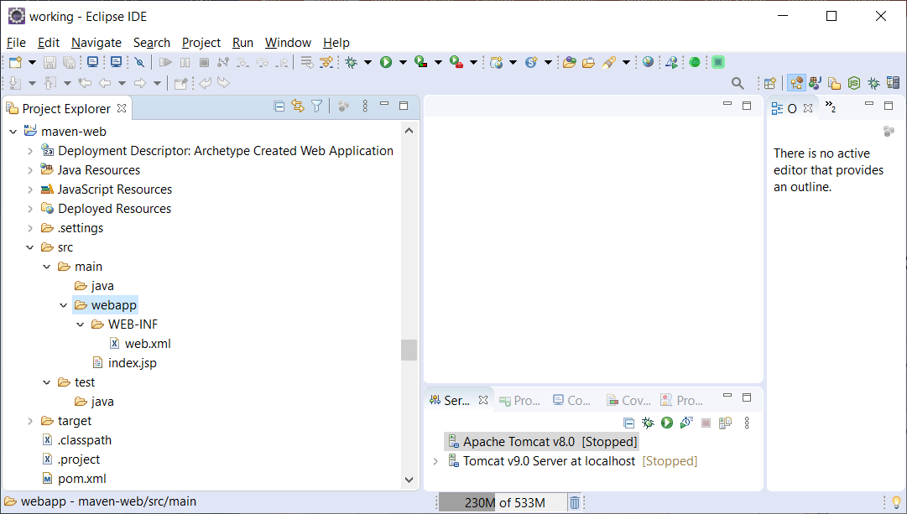
Maven
Eclipse IDE Plugin
web project

Slide 28
Reference
https://maven.apache.org
https://www.jittagornp.me/blog/what-is-apache-maven/
https://www.jittagornp.me/blog/basic-maven-command-line/
https://www.baeldung.com/maven-archetype

Slide 29
Q & A

